Slide 1
Kalman Filter Examples

Slide 2
Static State Estimation
recall the static state estimation problem we have been studying
  the process or plant model
  the observation model

Slide 3
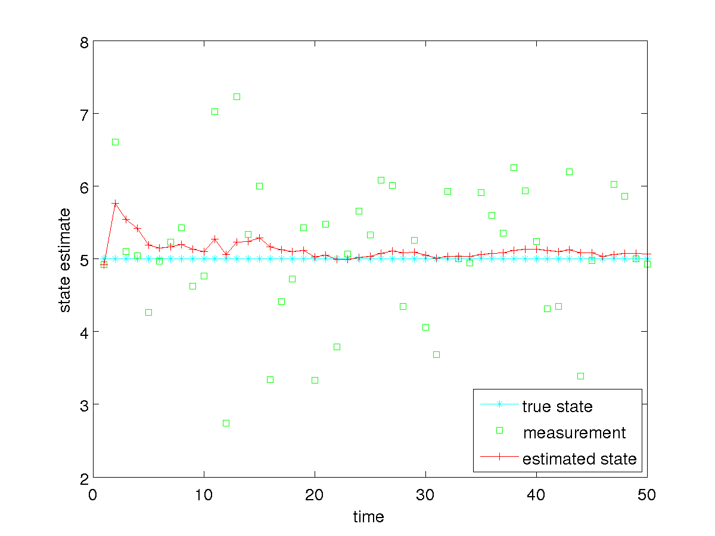
Static State Estimation
how well does the Kalman filter work

Slide 4
Static State Estimation
notice that we need to specify the measurement noise covariance Q_{t}
how sensitive is the Kalman filter to Q_{t} ?
  e.g., what if we use a Q_{t} that is much smaller than the actual measurement noise?
  e.g., what if we use a Q_{t} that is much larger than the actual measurement noise?

Slide 5
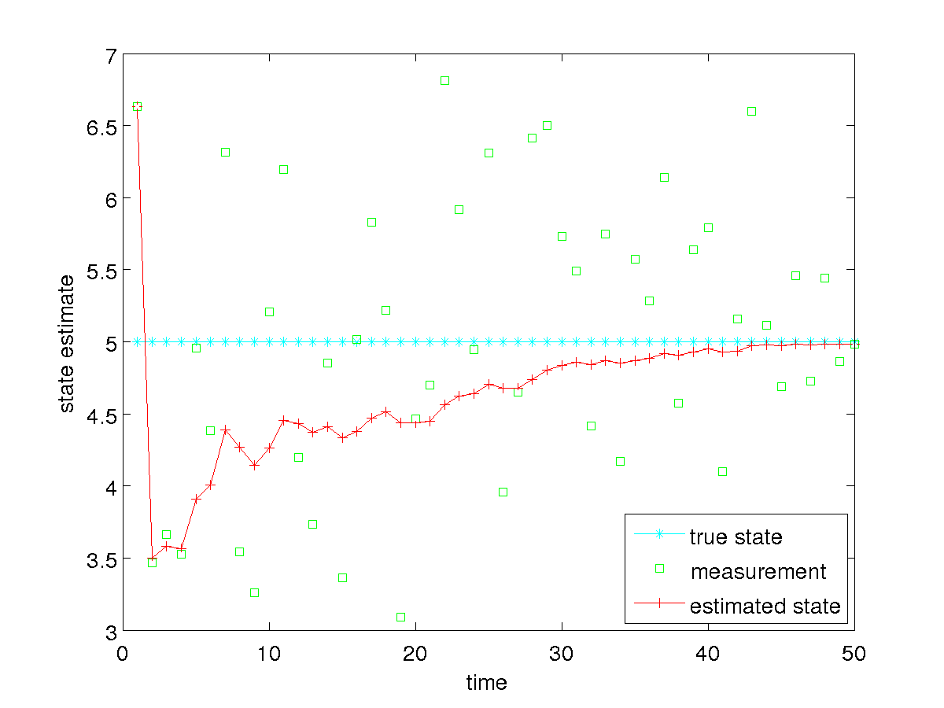
Static State Estimation
specified Q_{t} = 0.01 * actual Q_{t}

Slide 6
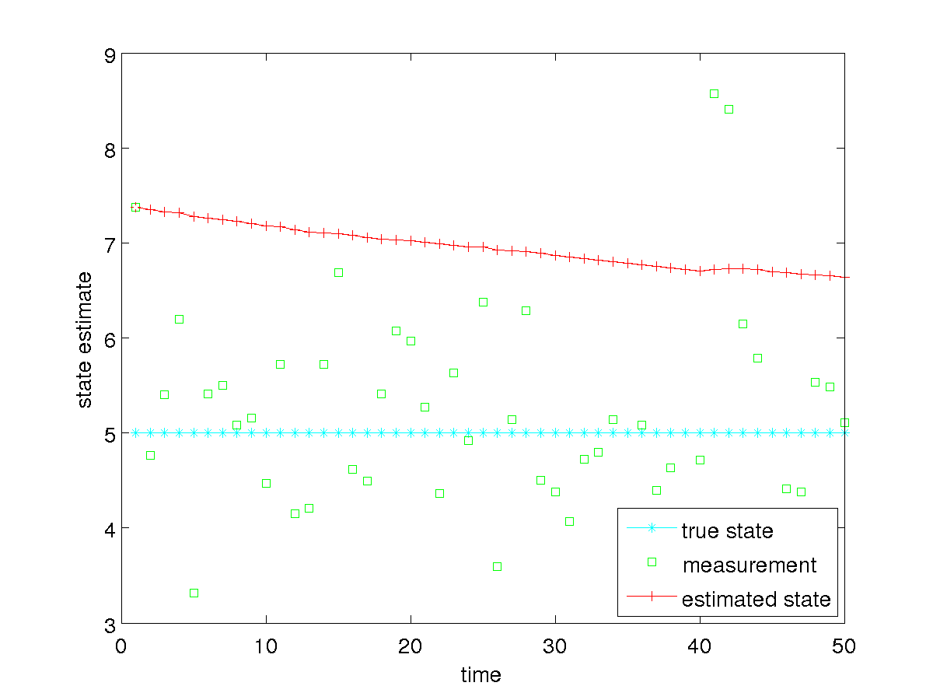
Static State Estimation
specified Q_{t} = 100 * actual Q_{t}

Slide 7
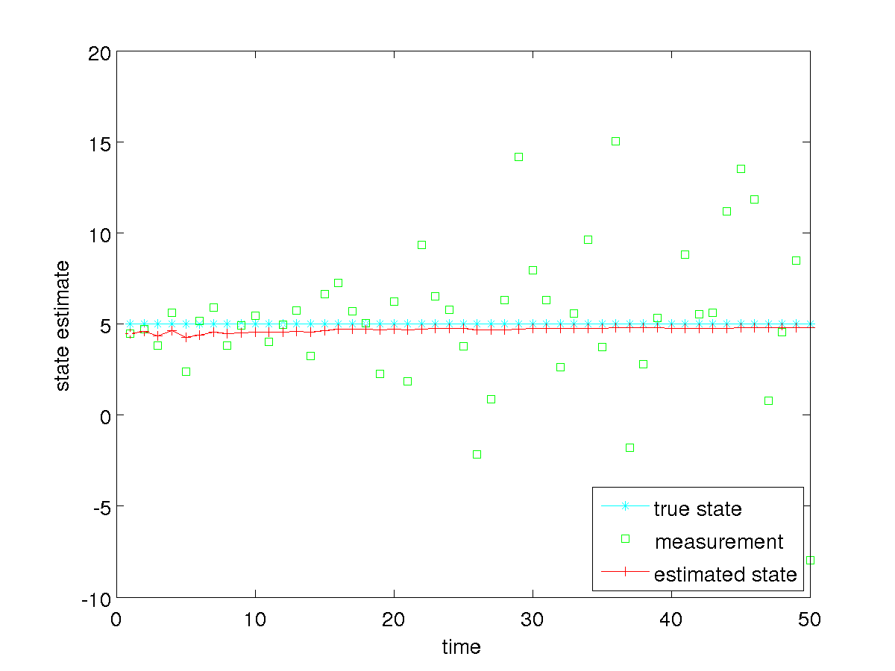
Static State Estimation
suppose our measurements get progressively noisier over time
noise variance increases 10% for each successive measurement

Slide 8
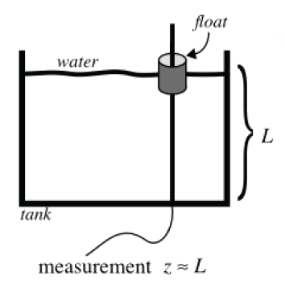
Tank of Water
estimate the level of water in the tank; the water could be
  static, filling, or emptying
  not sloshing or sloshing

Slide 9
Tank of Water
static level
plant model
measurement model

Slide 10
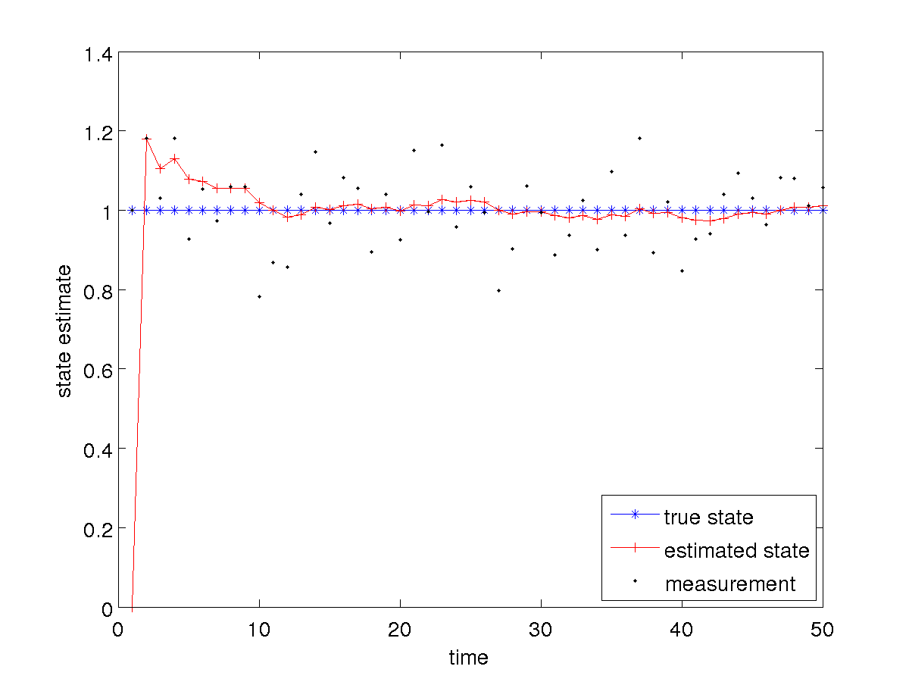
Tank of Water: Static and Not Sloshing

Slide 11
Tank of Water: Static and Not Sloshing
notice that in this case the Kalman filter tends towards estimating a constant level because the plant noise covariance is small compared to the measurement noise covariance
  the estimated state is much smoother than the measurements
what happens if we increase the plant noise covariance?

Slide 12
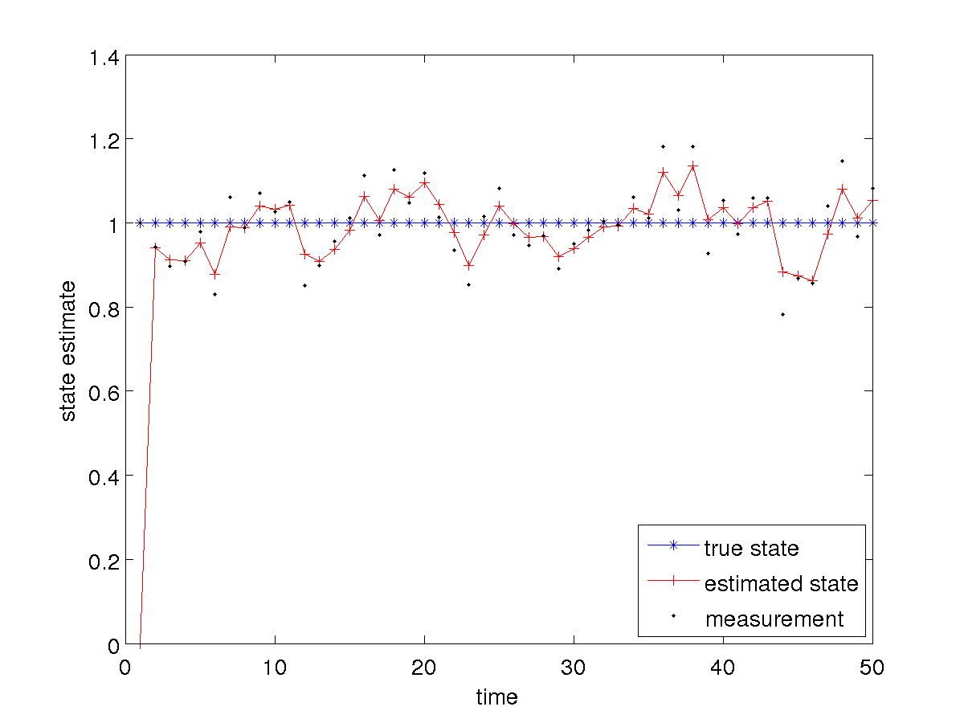
Tank of Water: Filling and Not Sloshing

Slide 13
Tank of Water: Static and Not Sloshing
notice that in this case the Kalman filter tends towards estimating values that are closer to the measurements
increasing the plant noise covariance causes the filter to place more weight on the measurements

Slide 14
Tank of Water: Filling and not Sloshing
suppose the true situation is that the tank is filling at a constant rate but we use the static tank plant model
  i.e., we have a plant model that does not accurately model the state transition

Slide 15
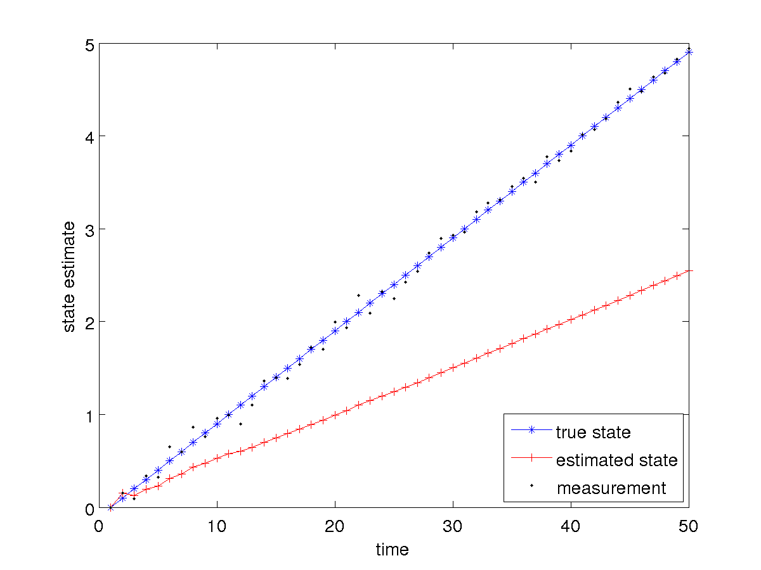
Tank of Water: Filling and not Sloshing

Slide 16
Tank of Water: Filling and not Sloshing
notice that in this case the estimated state trails behind the true level
  estimated state has a much greater error than the noisy measurements
if the plant model does not accurately model reality than you can expect poor results
  however, increasing the plant noise covariance will allow the filter to weight the measurements more heavily in the estimation…

Slide 17
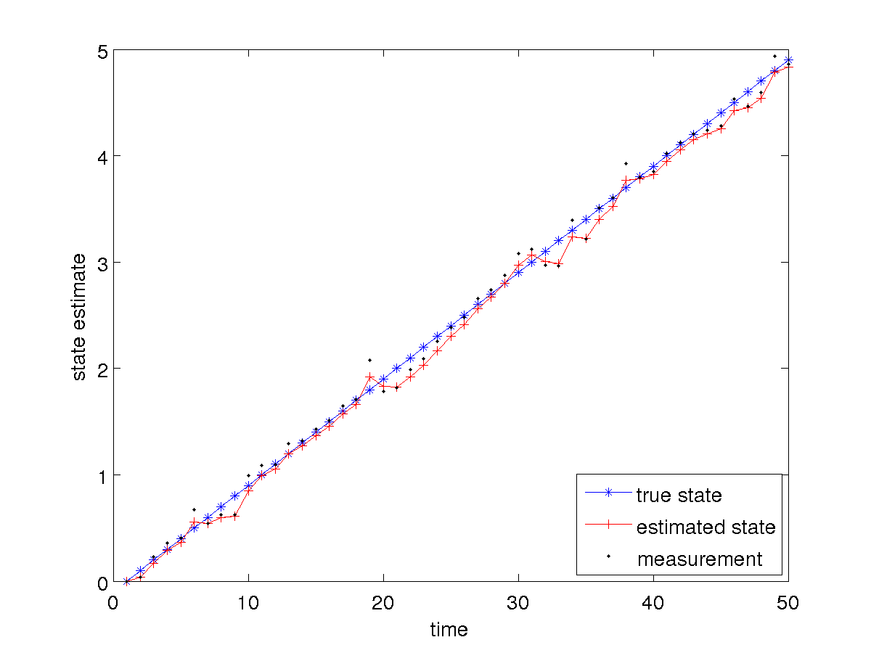
Tank of Water: Filling and not Sloshing

Slide 18
Tank of Water: Filling and not Sloshing
it is not clear if we have gained anything in this case
  the estimated state is reasonable but it is not clear if it is more accurate than the measurements
what happens if we change the plant model to more accurately reflect the filling?

Slide 19
Tank of Water
filling at a (noisy) constant rate and we do not care about the rate
u_{t} is the change in the water level that occurred from time t-1 to t
plant model
measurement model

Slide 20
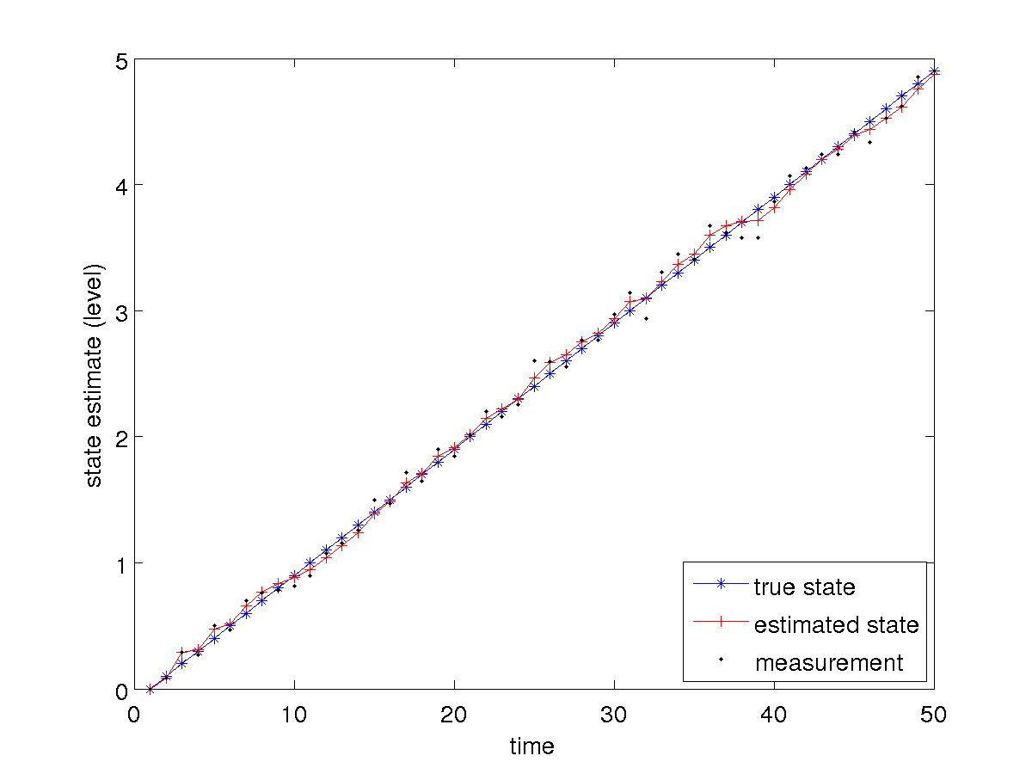
Tank of Water: Filling and not Sloshing

Slide 21
Tank of Water: Filling and not Sloshing
notice that the estimated state is more accurate and smoother than the measurements
what about the filling rate?

Slide 22
Tank of Water
filling at a (noisy) constant rate and we want to estimate the rate
plant model
measurement model

Slide 23
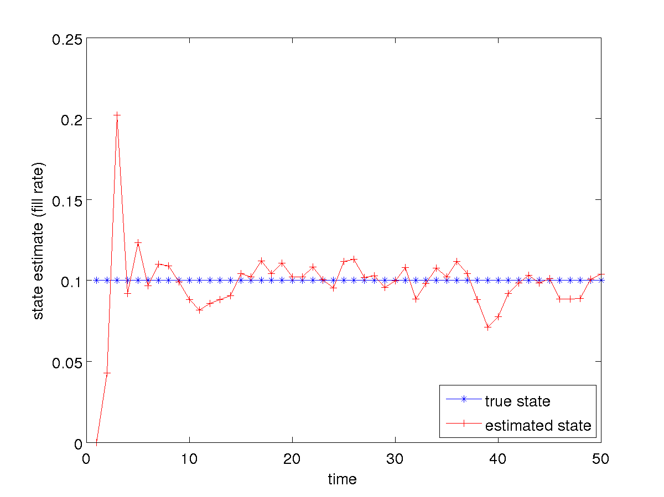
Tank of Water: Filling and not Sloshing

Slide 24
Tank of Water: Filling and not Sloshing
notice that the estimated filling rate seems to jump more than the estimated level
  this should not be surprising as we never actually measure the filling rate directly
    it is being inferred from the measured level (which is quite noisy)

Slide 25
Tank of Water: Static and not Sloshing
can we trick the filter by using the filling plant model when the level is static?
  hopefully not, as the filter should converge to a fill rate of zero!

Slide 26
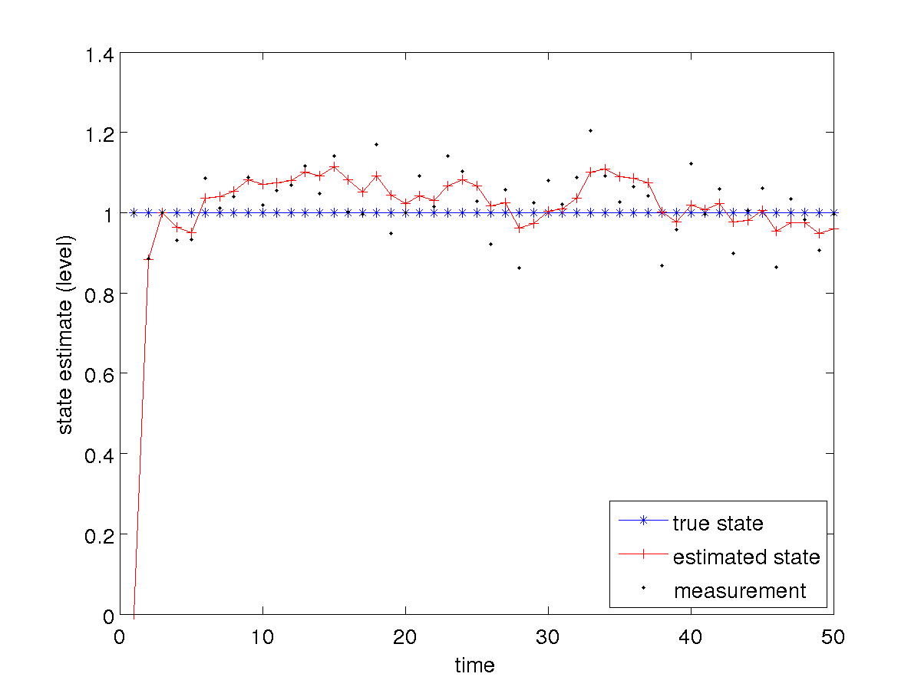
Tank of Water: Static and not Sloshing

Slide 27
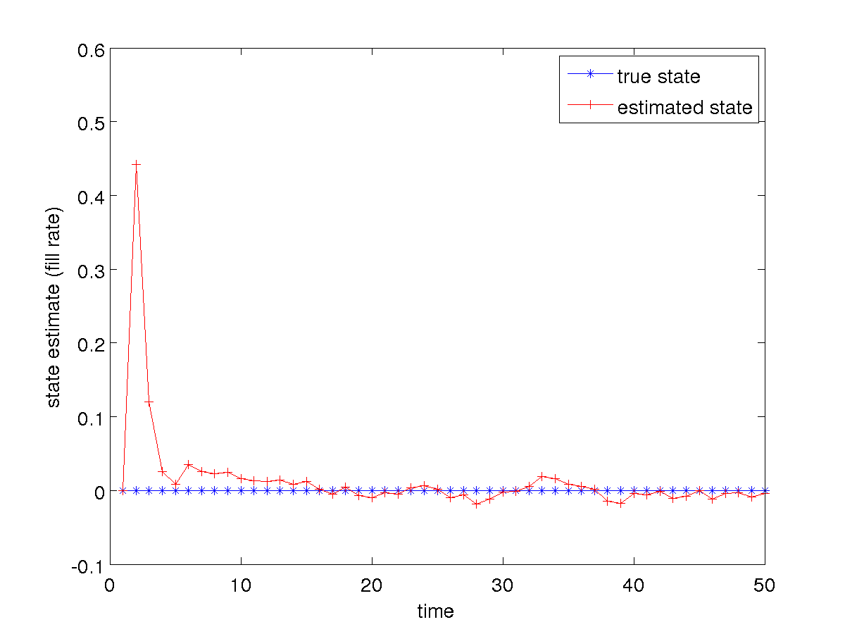
Tank of Water: Static and not Sloshing

Slide 28
Projectile Motion
projectile launched from some initial
point with some initial velocity under
the influence of gravity (no drag)

Slide 29
Projectile Motion
convert the continuous time equations to discrete recurrence relations for some time step

Slide 30
Projectile Motion
rewrite in matrix form

Slide 31
Omnidirectional Robot
an omnidirectional robot is a robot that can move in any direction (constrained in the ground plane)
  http://www.youtube.com/watch?v=DPz-ullMOqc
  http://www.engadget.com/2011/07/09/curtis-boirums-robotic-car-makes-omnidirectional-dreams-come-tr/
if we are not interested in the orientation of the robot then its state is simply its location

Slide 32
Omnidirectional Robot
a possible choice of motion control is simply a change in the location of the robot
with noisy control inputs

Slide 33
Differential Drive
recall that we developed two motion models for a differential drive
  using the velocity model, the control inputs are

Slide 34
Differential Drive
using the velocity motion model the discrete time forward kinematics are
Eqs 5.9

Slide 35
Differential Drive
there are two problems when trying to use the velocity motion model in a Kalman filter
  the plant model is not linear in the state and control
  it is not clear how to describe the control noises as a plant covariance matrix

Slide 36
Measurement Model
there are potentially other problems
  any non-trivial measurement model will be non-linear in terms of the state
consider using the known locations of landmarks in a measurement model

Slide 37
Landmarks
a landmark is literally a prominent geographic feature of the landscape that marks a known location
in common usage, landmarks now include any fixed easily recognizable objects
  e.g., buildings, street intersections, monuments
for mobile robots, a landmark is any fixed object that can be sensed

Slide 38
Landmarks for Mobile Robots
visual
  artificial or natural
retro-reflective
beacons
  LORAN (Long Range Navigation): terrestrial radio; now being phased out
  GPS: satellite radio
acoustic
scent?

Slide 39
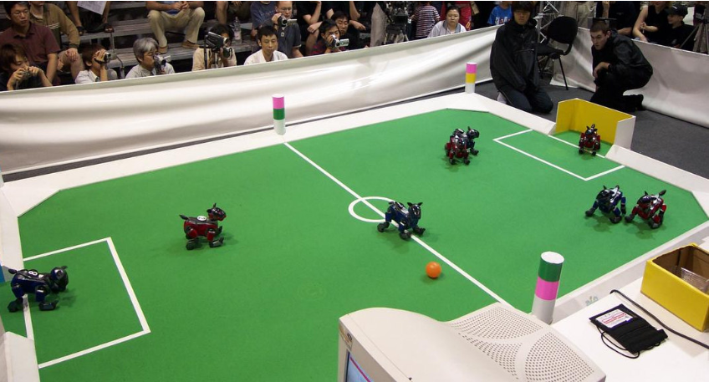
Landmarks: RoboSoccer

Slide 40
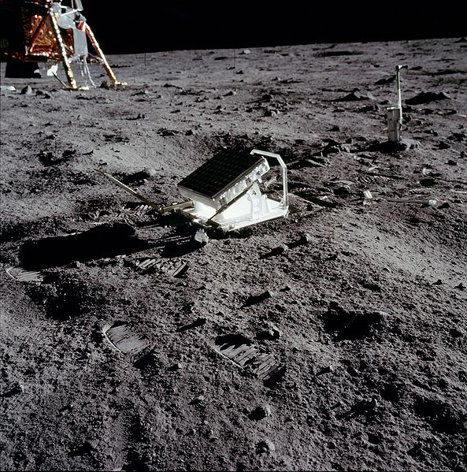
Landmarks: Retroreflector

Slide 41
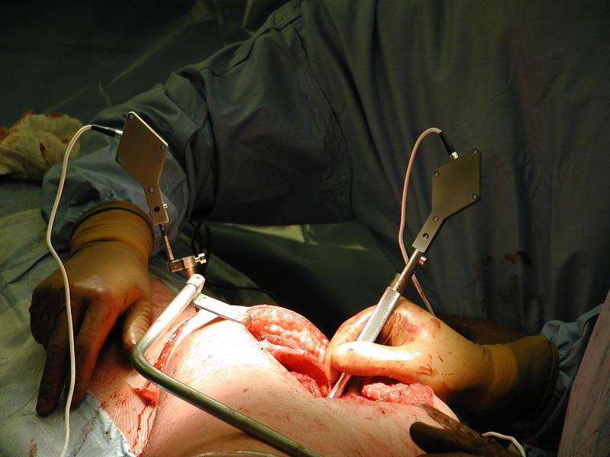
Landmarks: Active Light

Slide 42
Trilateration
uses distance measurements to two or more landmarks
suppose a robot measures the distance d₁ to a landmark
  the robot can be anywhere on a circle of radius d₁ around the landmark
d₁
landmark

Slide 43
Trilateration
without moving, suppose the robot measures the distance d₂ to a second landmark
  the robot can be anywhere on a circle of radius d₂ around the second landmark
d₁
d₂
landmark
landmark

Slide 44
Trilateration
the robot must be located at one of the two intersection points of the circles
  tie can be broken if other information is known
d₁
d₂
landmark
landmark

Slide 45
Trilateration
if the distance measurements are noisy then there will be some uncertainty in the location of the robot

Slide 46
Trilateration
notice that the uncertainty changes depending on where the robot is relative to the landmarks
uncertainty grows quickly if
the robot is in line with the
landmarks

Slide 47
Trilateration
uncertainty grows as the
robot moves farther
away from the landmarks
  but not as dramatically
  as the previously slide

Slide 48
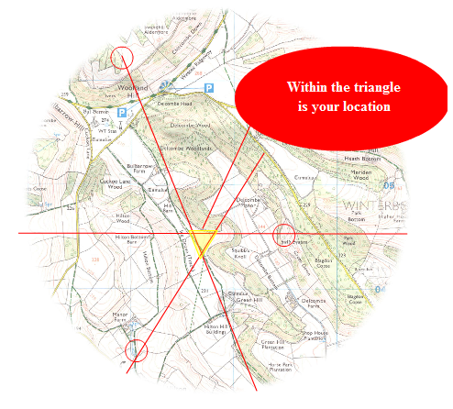
Triangulation
triangulation uses angular information to infer position
  http://longhamscouts.org.uk/content/view/52/38/

Slide 49
Triangulation
in robotics the problem often appears as something like:
  suppose the robot has a (calibrated) camera that detects two landmarks (with known location)
    then we can determine the angular separation, or relative bearing, α between the two landmarks
known
position
D₁
known
position
Z₁
Z₂
α
unknown
position

Slide 50
Triangulation
the unknown position must lie somewhere on a circle arc
  Euclid proved that any point on the shown circular arc forms an inscribed triangle with angle α
    we need at least one more beacon to estimate the robot’s location
known
position
D₁
known
position
α
α

Slide 51
Triangulation
the unknown position must lie somewhere on a circle arc
  Euclid proved that any point on the shown circular arc forms an inscribed triangle with angle α
    we need at least one more beacon to estimate the robot’s location
D₁
D₂
α
β

Slide 52
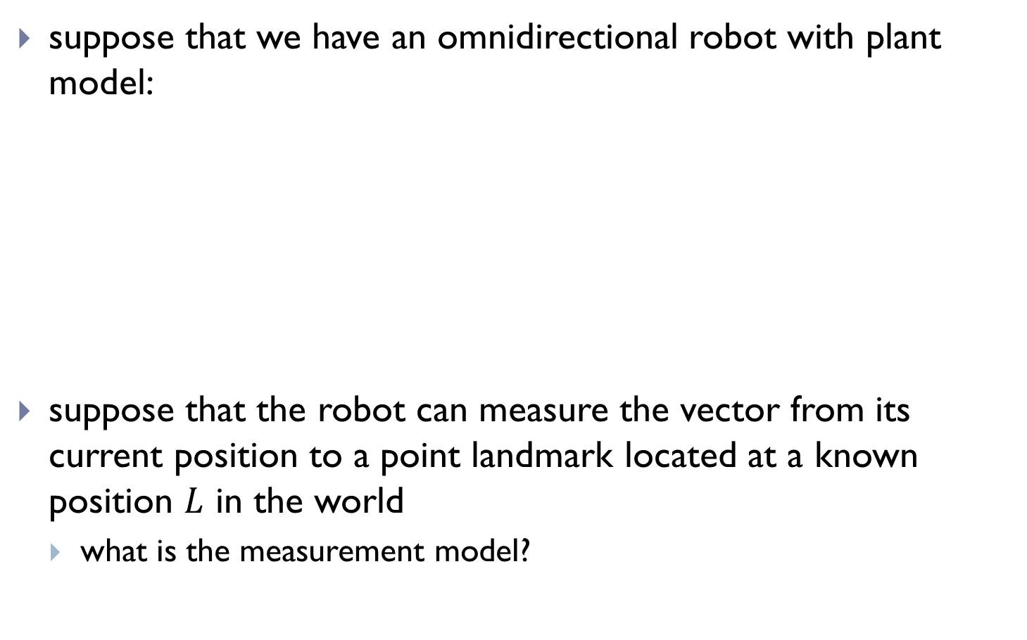
Kalman Filter with Landmarks
suppose that we have an omnidirectional robot with plant model:
suppose that the robot can measure the vector from its current position to a point landmark located at a known position $L$ in the world
  what is the measurement model?

Slide 53
Kalman Filter with Landmarks
measurement model:
is the measurement model linear?

Slide 54
Kalman Filter with Landmarks
can we make the measurement model linear?

Slide 55
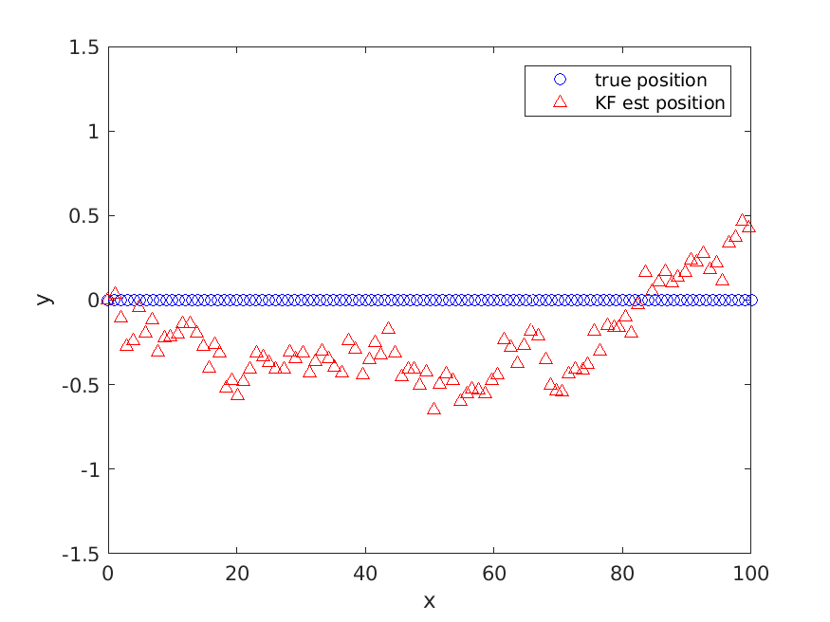
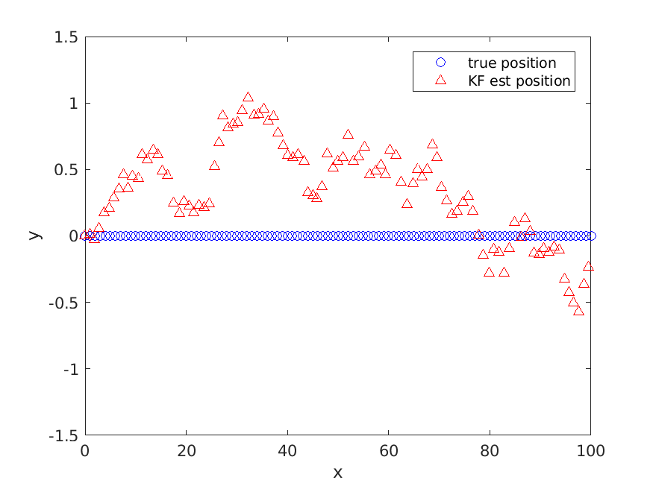
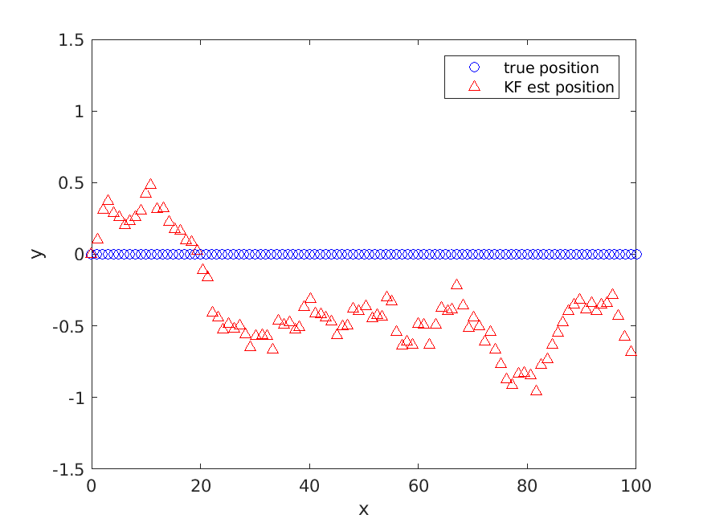
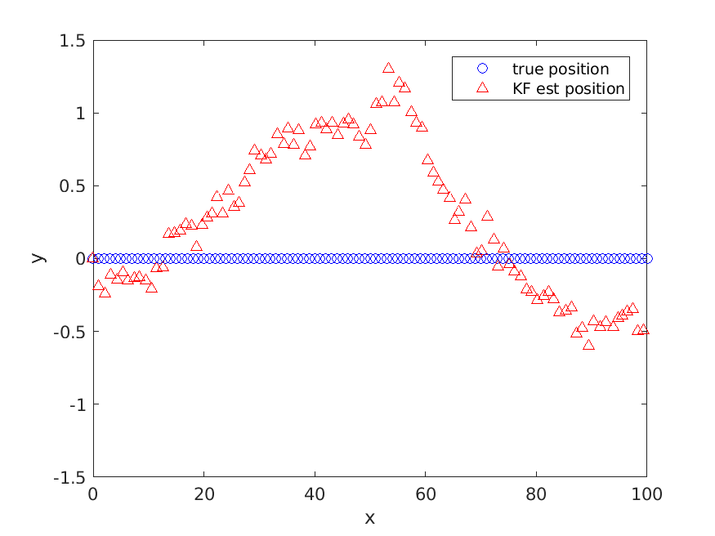
Kalman Filter with Landmarks

Slide 56
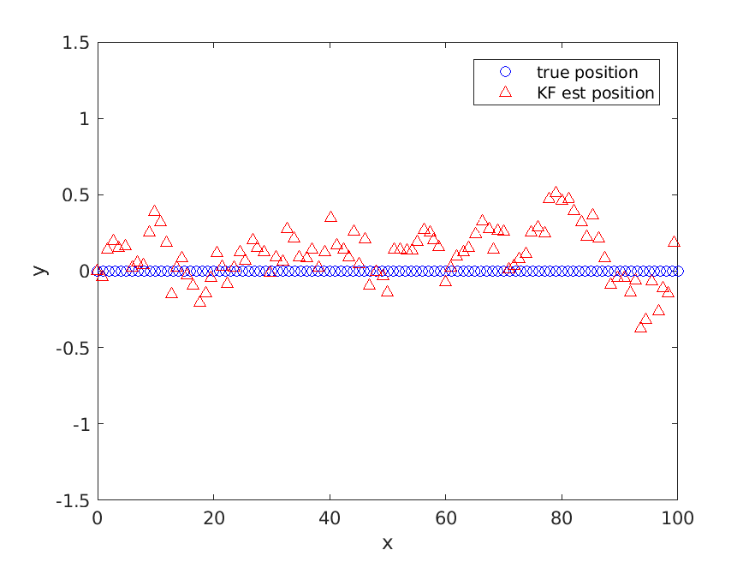
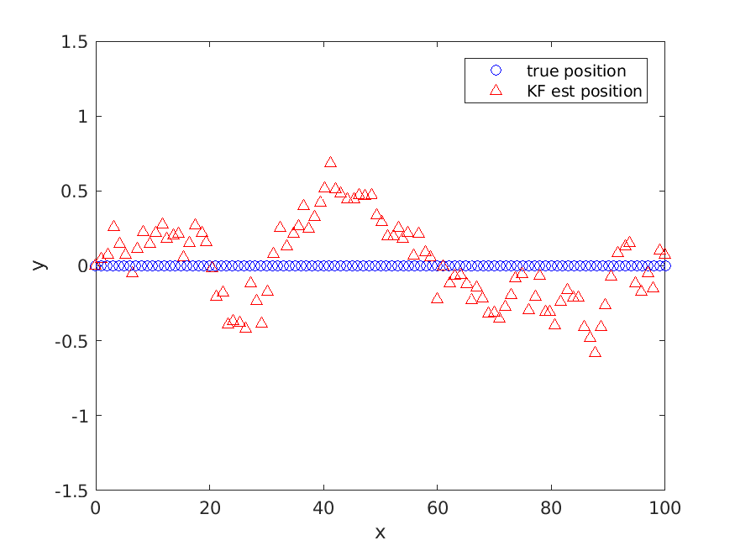
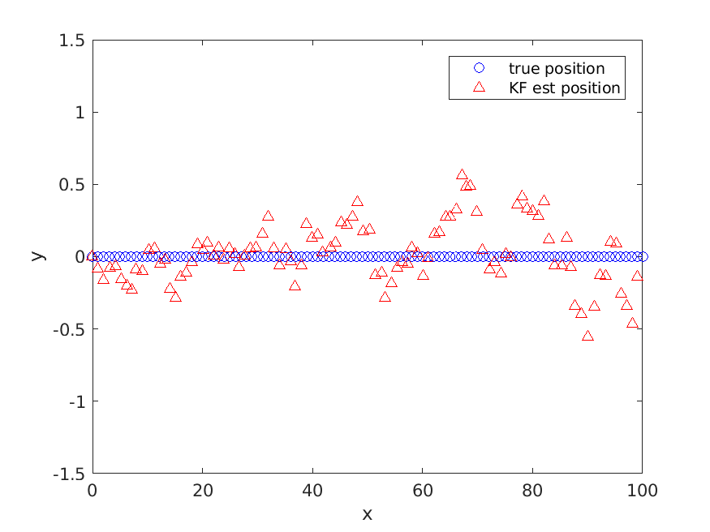
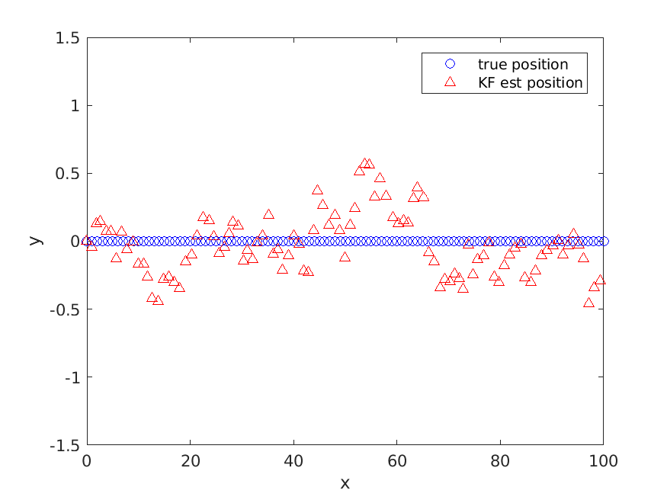
Kalman Filter with Landmarks

Slide 57
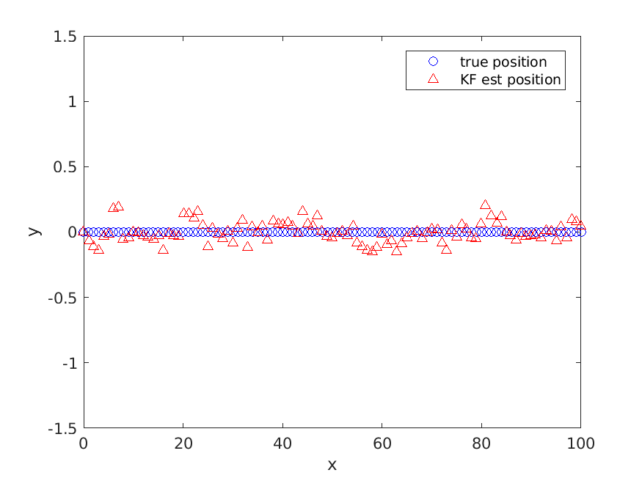
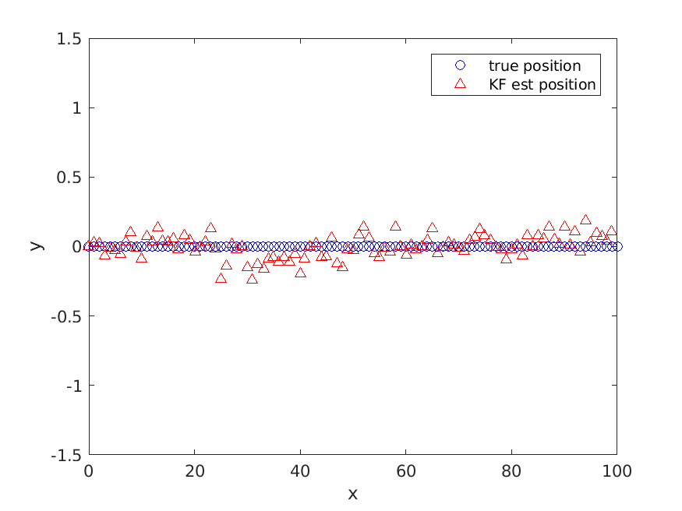
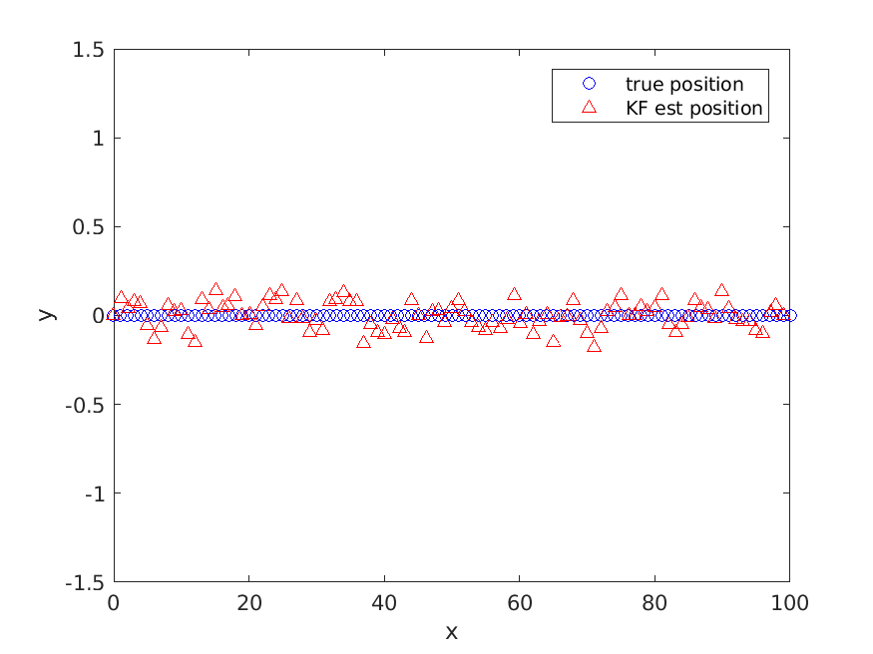
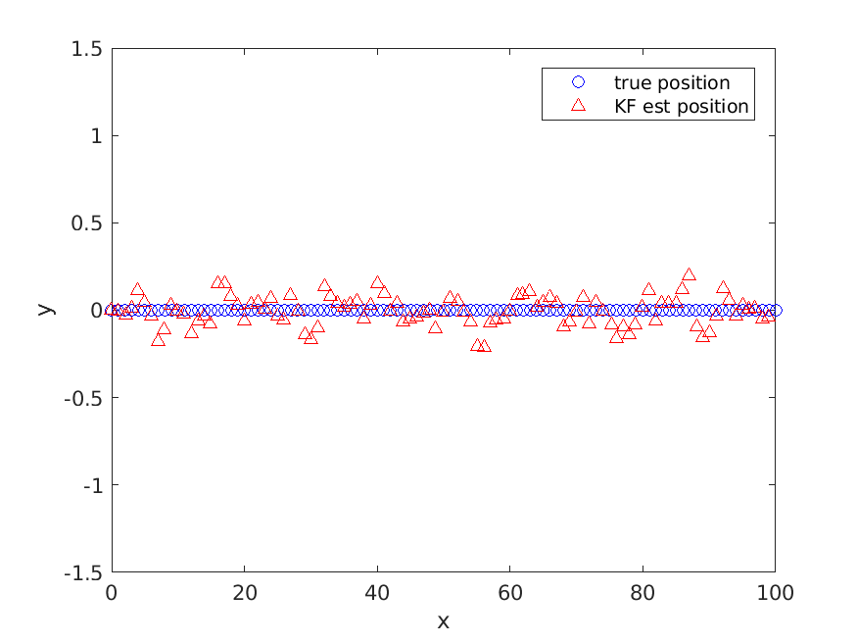
Kalman Filter with Landmarks

